Slide 1





How environmental change affects animal movement
Stefano Mezzini – Ph.D. Biol.

Slide 2
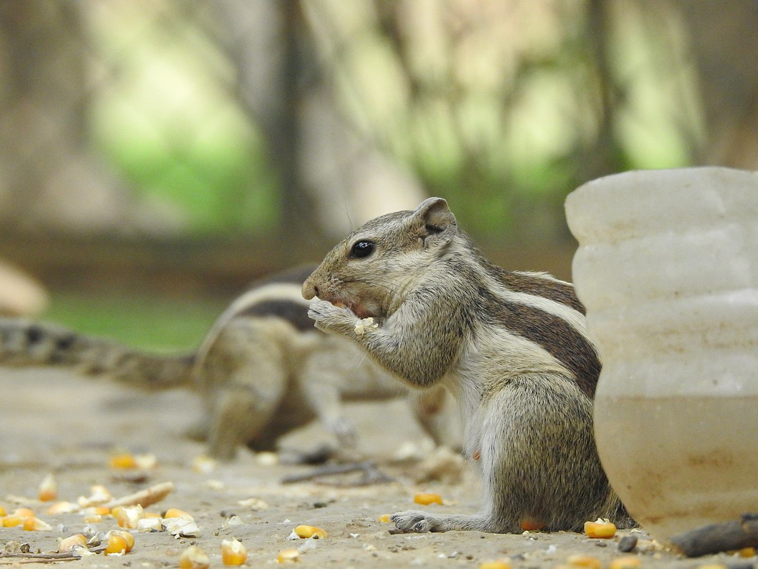
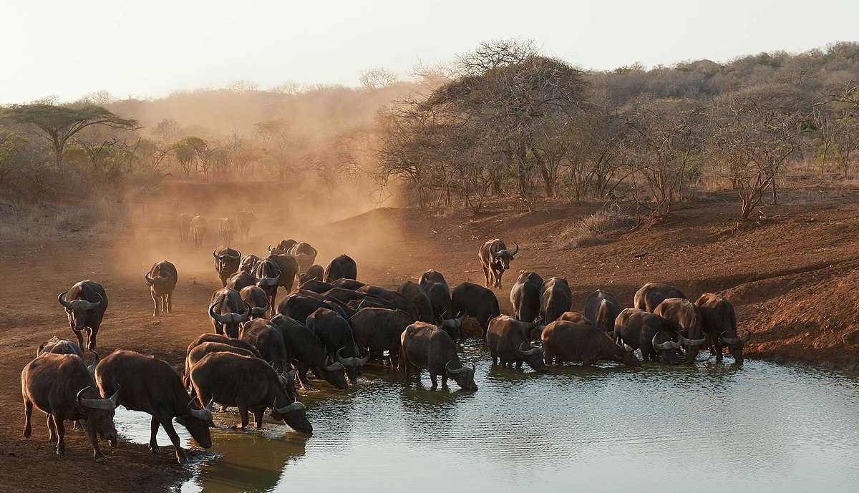
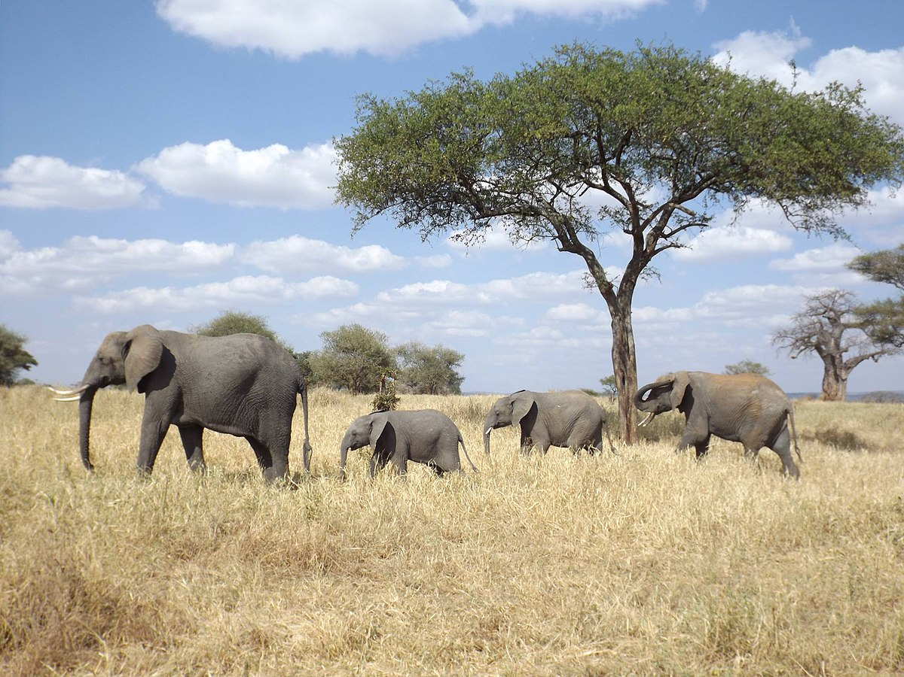
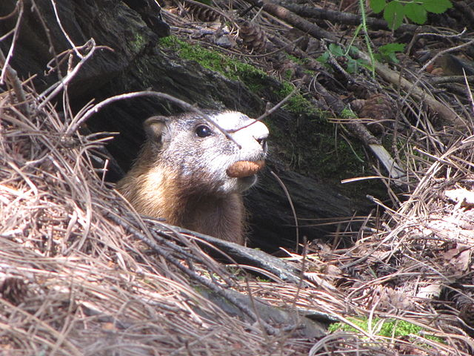
Why do animals move?
African buffalos drinking at a pond
photo by safaritravelplus, CC0, via Wikimedia Commons
Food/nutrients
Water
New den/nest
Mate/group
And many other reasons…
Use home range size as a proxy for all needs
Foraging chipmunk, photo by Prashant Saini,
CC BY-SA 4.0, via Wikimedia Commons
Mother elephant with offspring,
photo by Floodmfx, CC0, via Wikimedia Commons
Black hills marmot, photo by Njschock,
CC BY-SA 3.0, via Wikimedia Commons

Slide 3
Resource abundance and HR

Slide 4
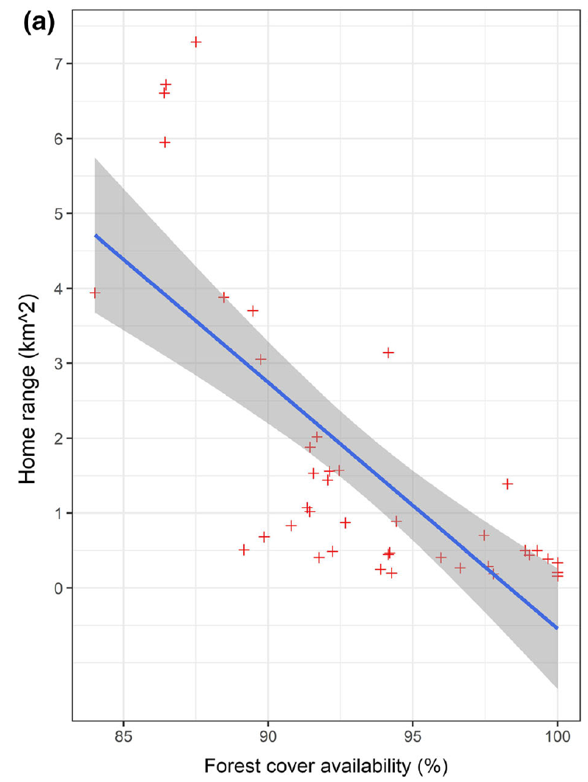
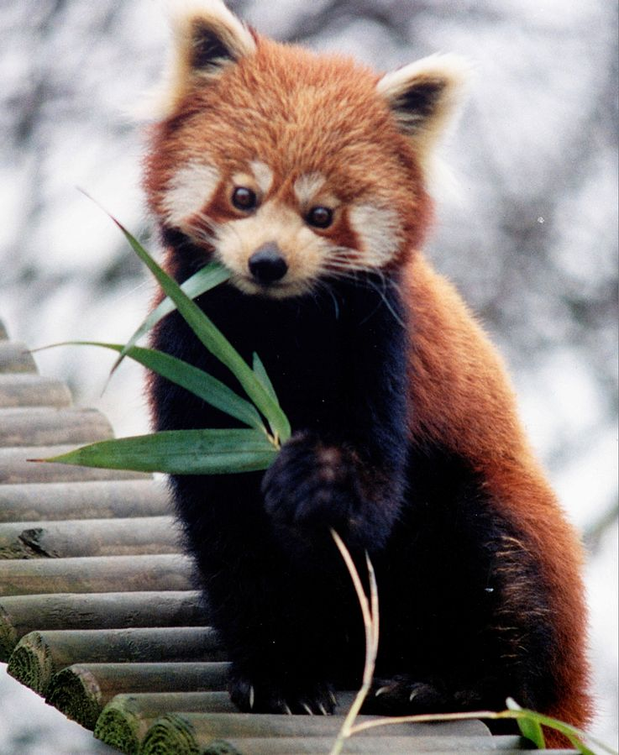
Resource abundance and HR: examples in literature
HR size (km²)
Red panda,
photo by Brunswyk, CC BY-SA 3.0,
via Wikimedia Commons
(Bista et al. 2022)
Forest cover (%)

Slide 5
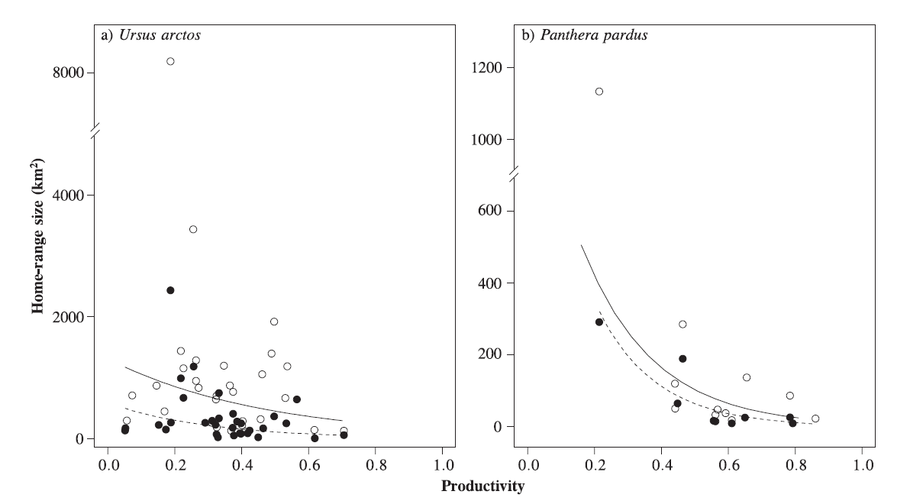
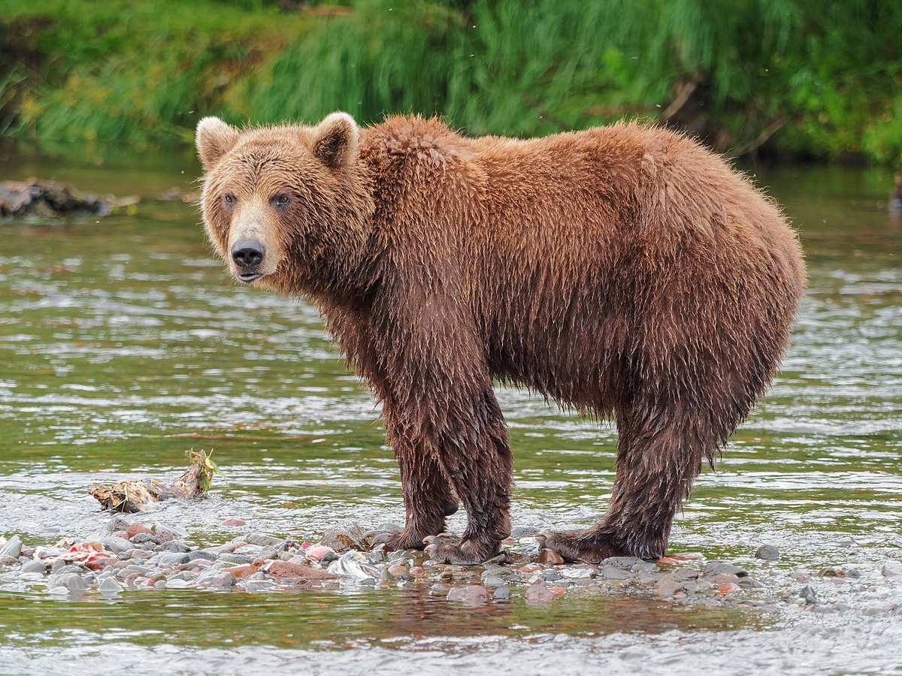
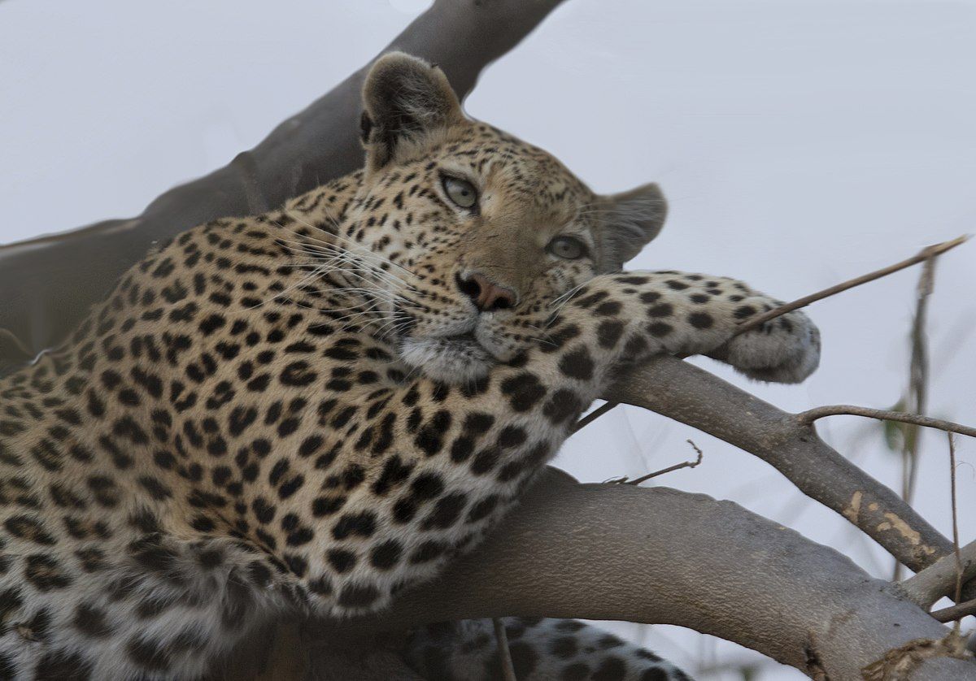
Resource abundance and HR: examples in literature
Brown bear, photo by Robert F. Tobler,
CC BY-SA 4.0, via Wikimedia Commons
Leopard, photo by Gregory "Slobirdr" Smith,
CC BY-SA 2.0, via Wikimedia Commons
HR size (km²)
Productivity (NDVI)
(Nilsen et al. 2005)

Slide 6
Resource abundance and HR : an abundance of evidence
Bista, D., G. S. Baxter, N. J. Hudson, S. T. Lama, and P. J. Murray. 2022. Effect of disturbances and habitat fragmentation on an arboreal habitat specialist mammal using GPS telemetry: A case of the red panda. Landscape Ecology 37:795–809.
Geremia, C., J. A. Merkle, D. R. Eacker, R. L. Wallen, P. J. White, M. Hebblewhite, and M. J. Kauffman. 2019. Migrating bison engineer the green wave. Proceedings of the National Academy of Sciences 116:25707–25713.
Herfindal, I., J. D. C. Linnell, J. Odden, E. B. Nilsen, and R. Andersen. 2005. Prey density, environmental productivity and home-range size in the Eurasian lynx (Lynx lynx). Journal of Zoology 265:63–71.
Lucherini, M., and S. Lovari. 1996. Habitat richness affects home range size in the red fox Vulpes vulpes. Behavioural Processes 36:103–105.
Nilsen, E. B., I. Herfindal, and J. D. C. Linnell. 2005. Can intra-specific variation in carnivore home-range size be explained using remote-sensing estimates of environmental productivity? Écoscience 12:68–75.
Relyea, R. A., R. K. Lawrence, and S. Demarais. 2000. Home Range of Desert Mule Deer: Testing the Body-Size and Habitat-Productivity Hypotheses. The Journal of Wildlife Management 64:146.
Rickbeil, G. J. M., J. A. Merkle, G. Anderson, M. P. Atwood, J. P. Beckmann, E. K. Cole, A. B. Courtemanch, et al. 2019. Plasticity in elk migration timing is a response to changing environmental conditions. Global Change Biology 25:2368–2381.
Williams-Guillen, K., C. McCann, J. C. Martinez Sanchez, and F. Koontz. 2006. Resource availability and habitat use by mantled howling monkeys in a Nicaraguan coffee plantation: Can agroforests serve as core habitat for a forest mammal? Animal Conservation 9:331–338.
…

Slide 7
Resource abundance and HR : common issues
Results reported as new findings
No unifying hypotheses

Slide 8
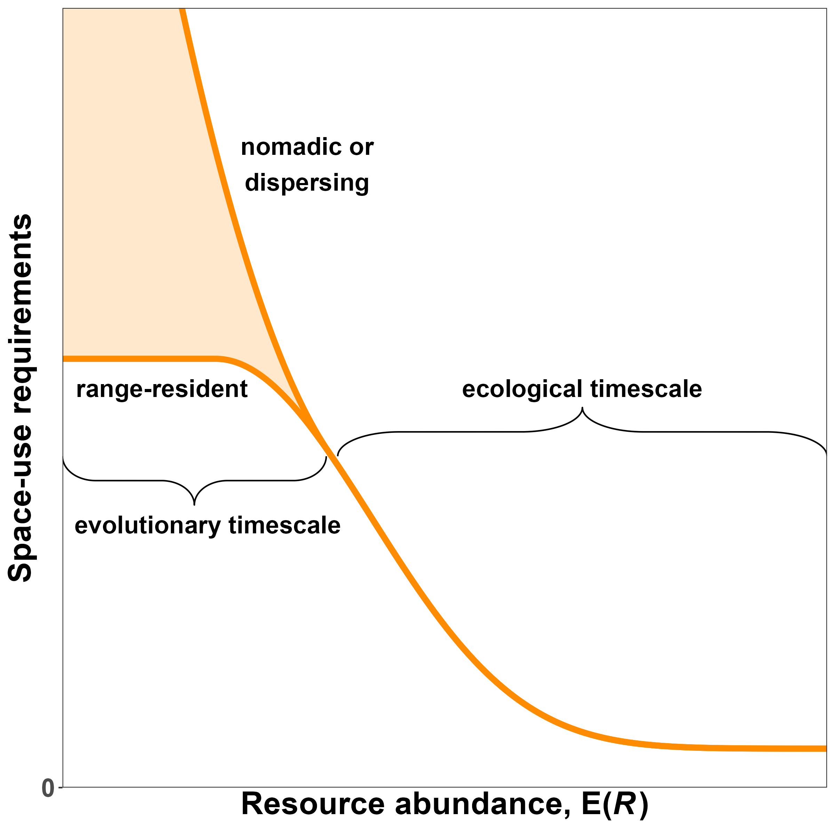
Resource abundance and HR: hypothesis
HR size (km²)
Forest cover (%)
HR size (km²)
HR size (km²)
Productivity (NDVI)

Slide 9
Resource unpredictability and HR

Slide 10
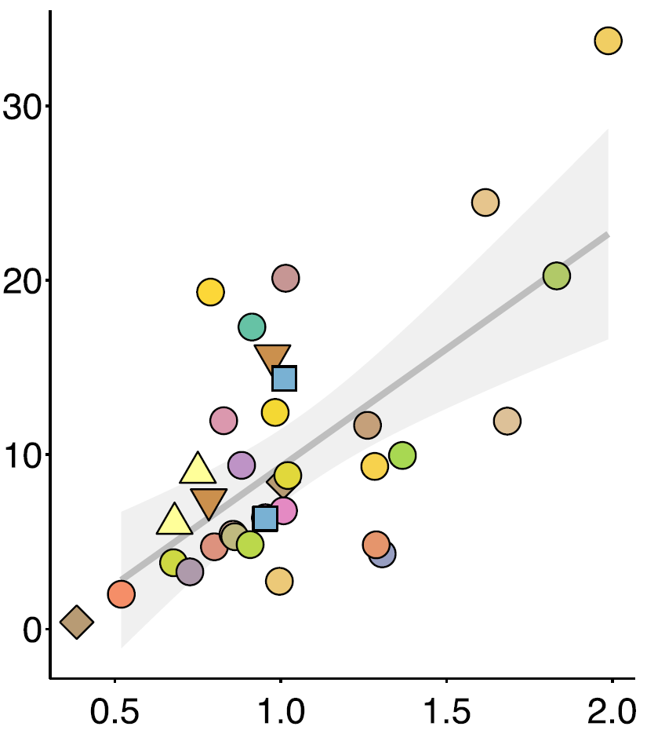
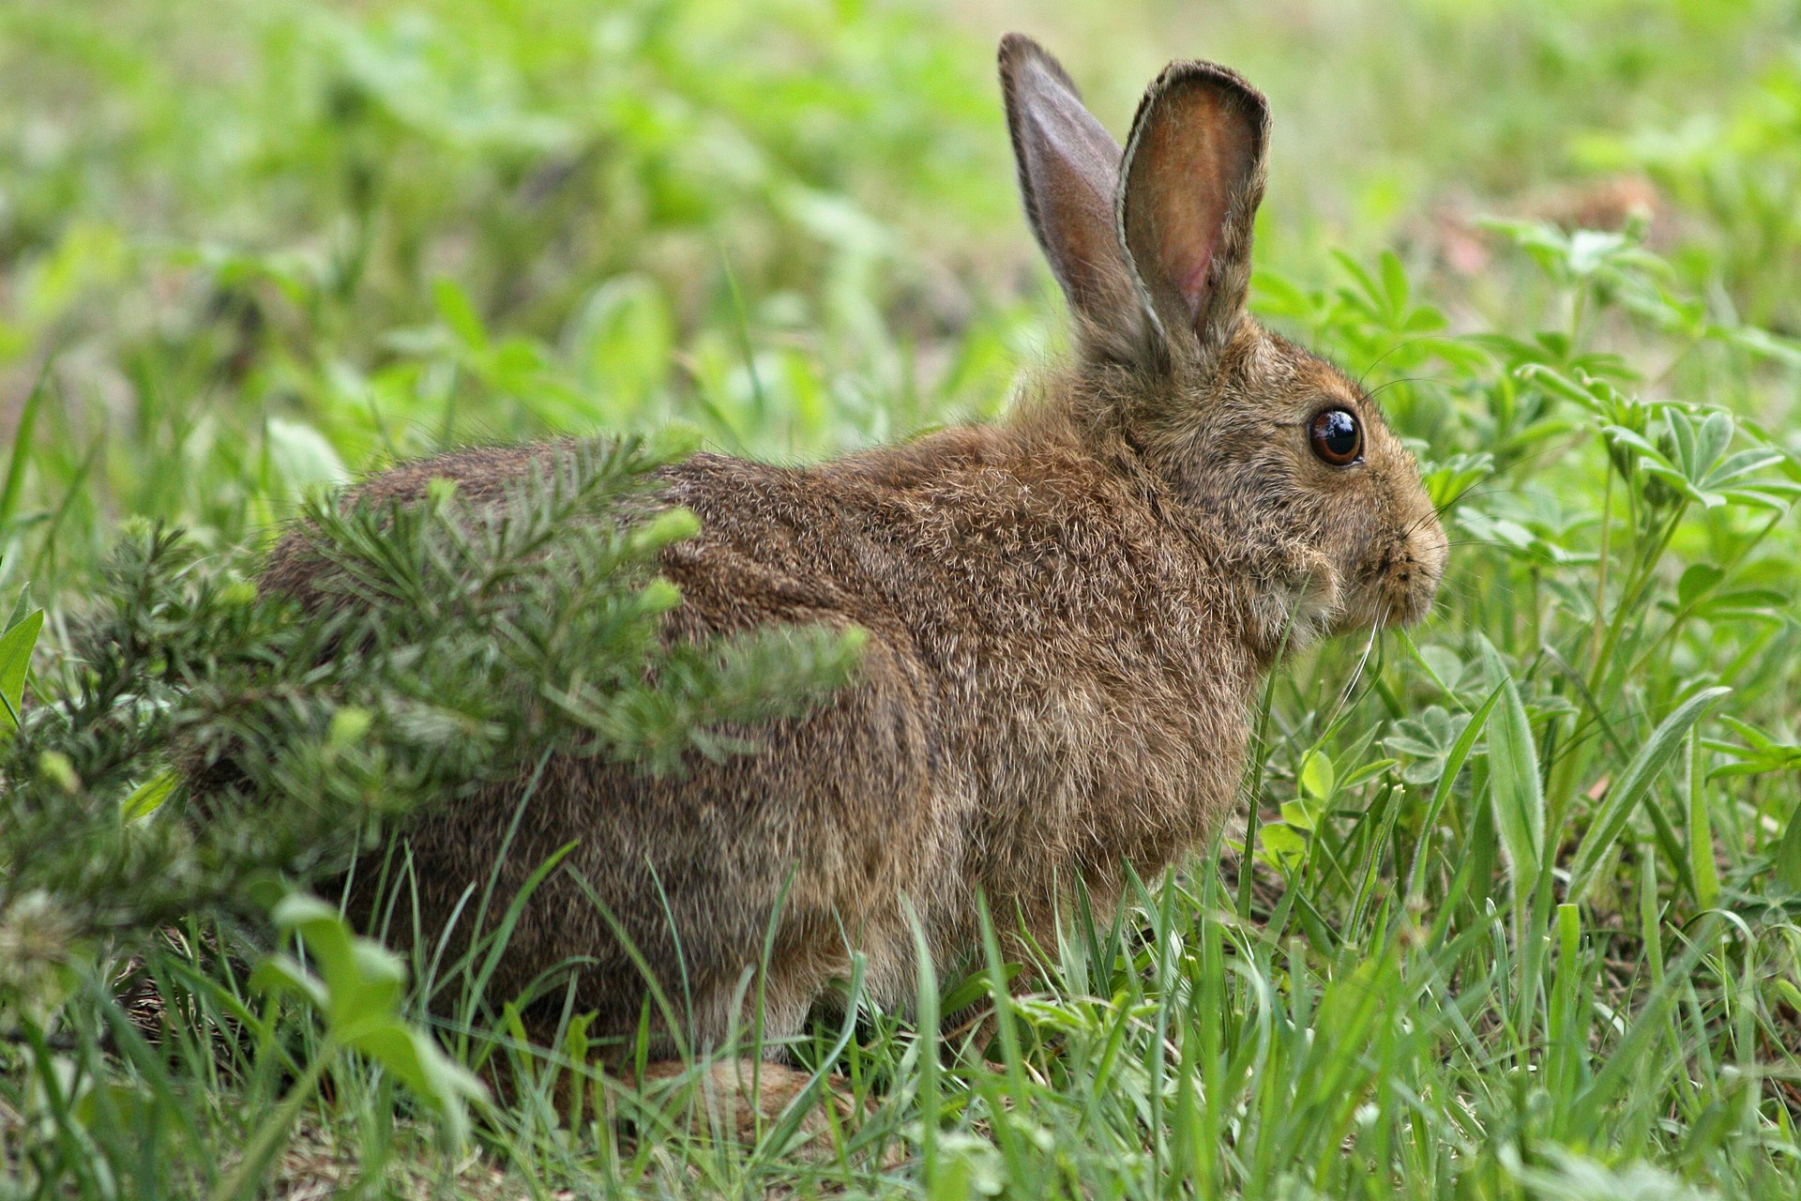
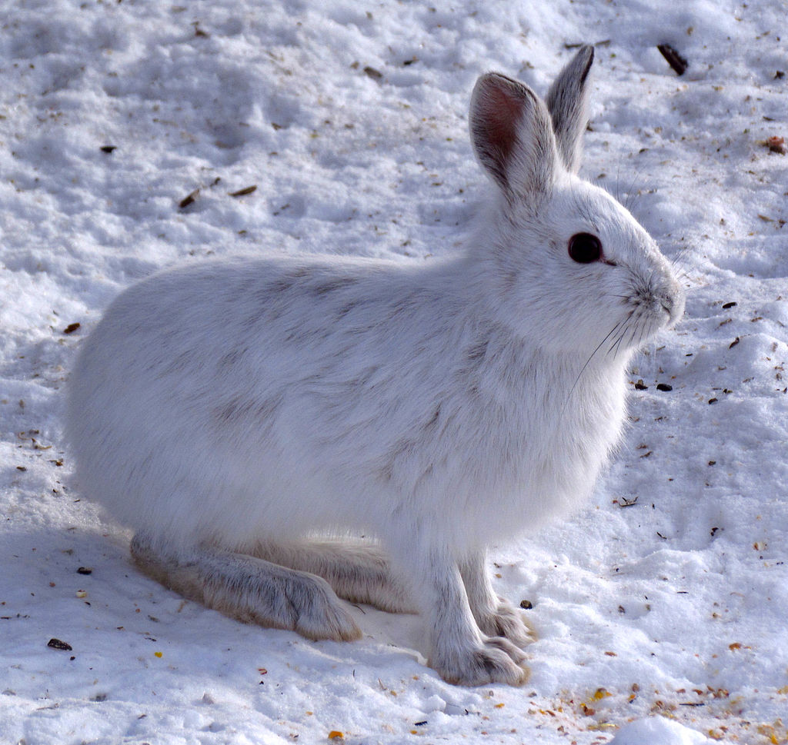
Resource unpredictability and HR: examples in literature
HR size (ha)
Nitrogen unpredictability (CV)
(Rizzuto et al. 2021)
Showshoe hares, photos by Walter Siegmund (top) and D. Gordon and
E. Robertson (bottom), CC BY-SA 3.0, via Wikimedia Commons

Slide 11
Resource unpredictability and HR : current evidence
Herfindal, I., J. D. C. Linnell, J. Odden, E. B. Nilsen, and R. Andersen. 2005. Prey density, environmental productivity and home-range size in the Eurasian lynx (Lynx lynx). Journal of Zoology 265:63–71.
Nilsen, E. B., I. Herfindal, and J. D. C. Linnell. 2005. Can intra-specific variation in carnivore home-range size be explained using remote-sensing estimates of environmental productivity? Écoscience 12:68–75.
Rizzuto M., Leroux S.J., Vander Wal E., Richmond I.C., Heckford T.R., Balluffi-Fry J., et al. (2021). Forage stoichiometry predicts the home range size of a small terrestrial herbivore. Oecologia 197, 327–338.

Slide 12
Resource unpredictability and HR: common issues
Results reported as new findings
No unifying hypotheses

Slide 13
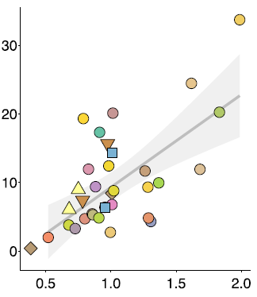
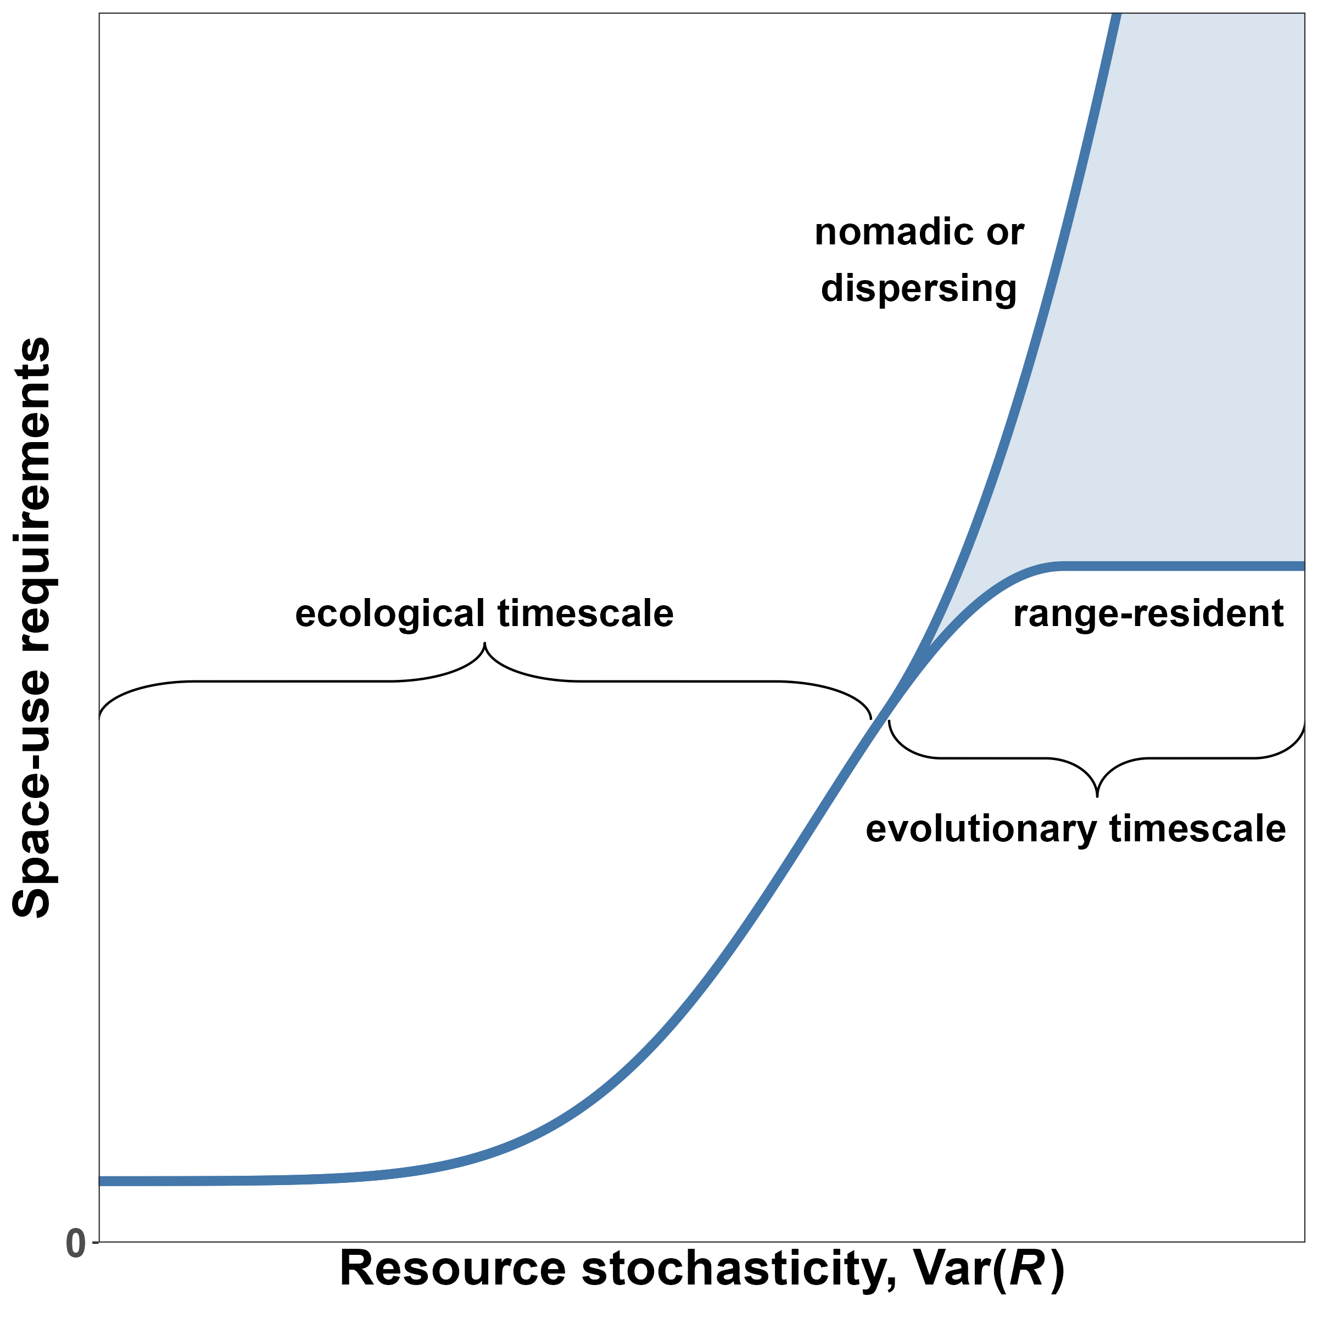
Resource unpredictability and HR: a unifying framework
HR ize (ha)
Nitrogen unpredictability
Showshoe hares, photos by D. Gordon and
E. Robertson (bottom), CC BY-SA 3.0, via Wikimedia Commons

Slide 14
New generalized hypotheses

Slide 15
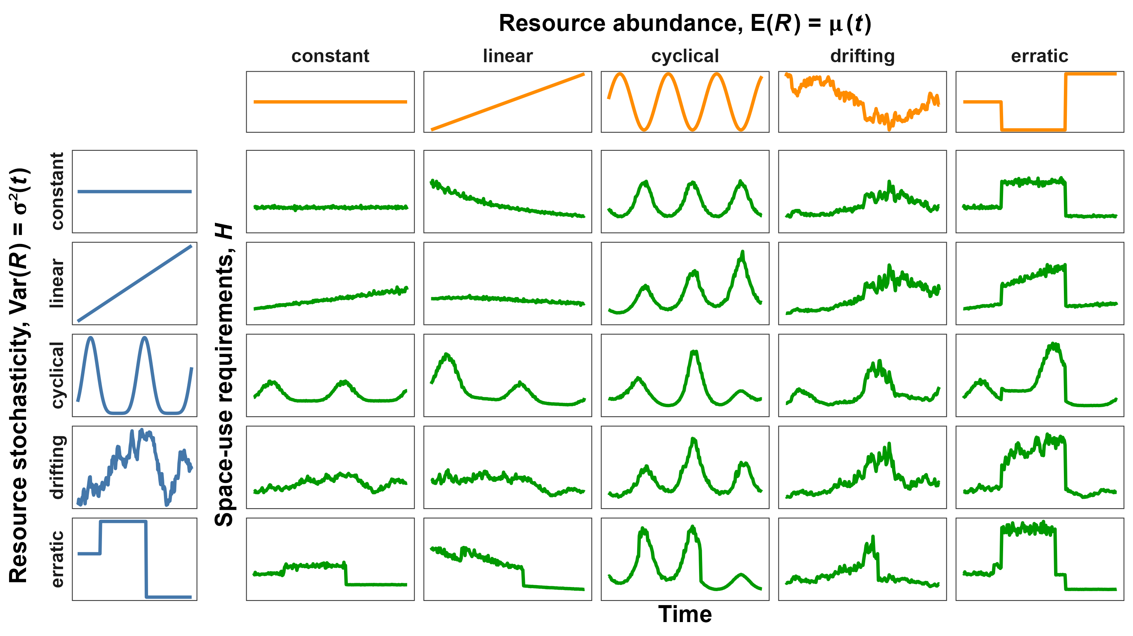
Chapter 1: Simulating the relationships

Slide 16
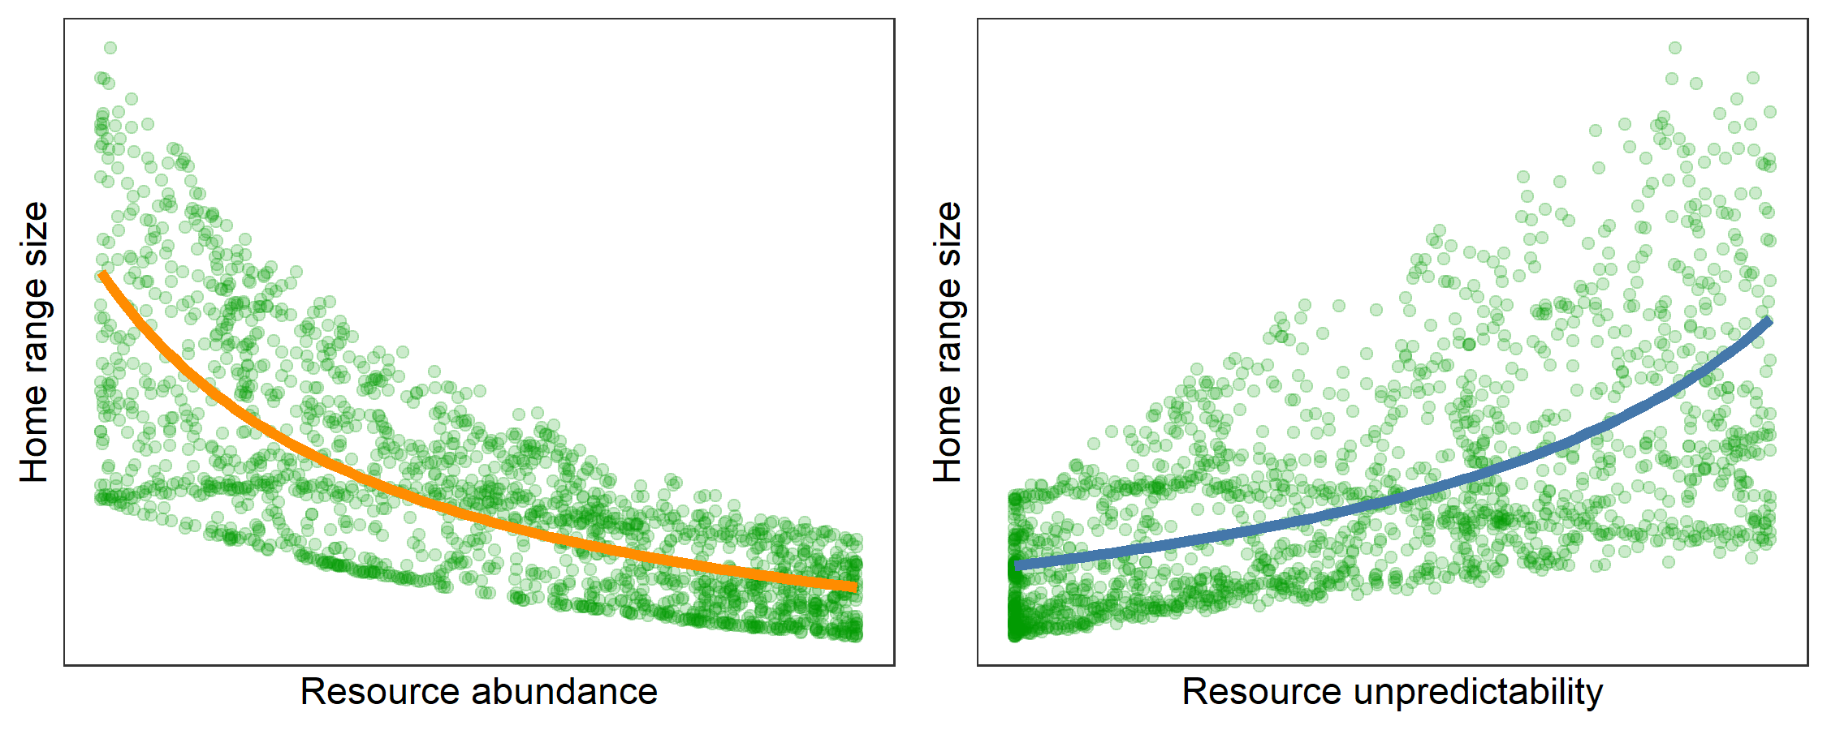
Chapter 1: Testing the hypotheses with simulated data

Slide 17
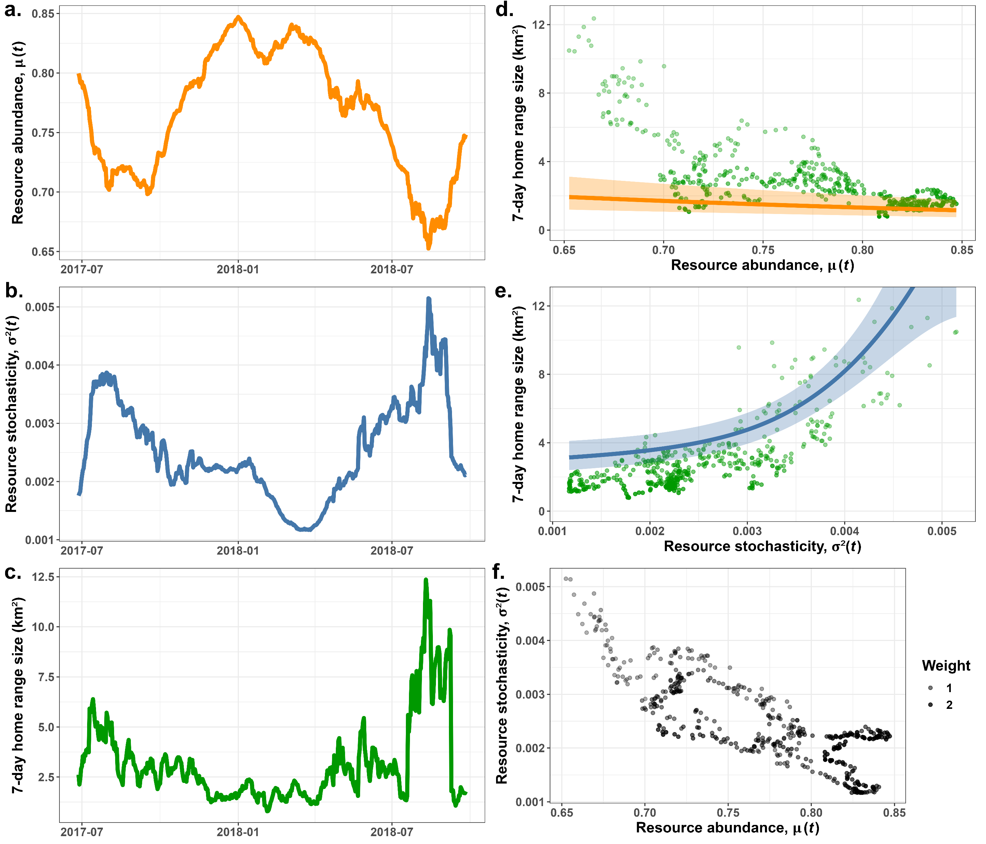
Chapter 1: Testing the hypotheses with real data
Preprint available at: https://www.biorxiv.org/content/10.1101/2023.11.03.565563v1

Slide 18
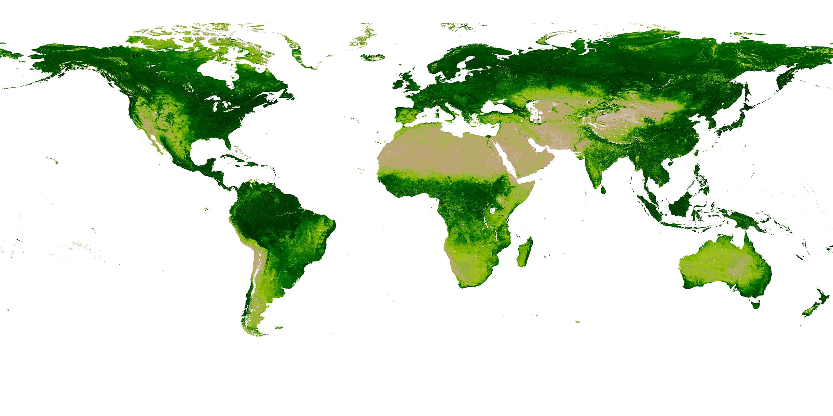
Chapter 2: Estimating abundance and unpredictability world-wide
NDVI:
Productivity
Seasonality
Weather, climate
Extreme events (burns, floods)
Does not account for prey or competitors
AVHRR data: daily, 0.5-degree rasters since 1980s (>900 GB!)
Map of NDVI by Ivan Shmakov (cropped)

Slide 19
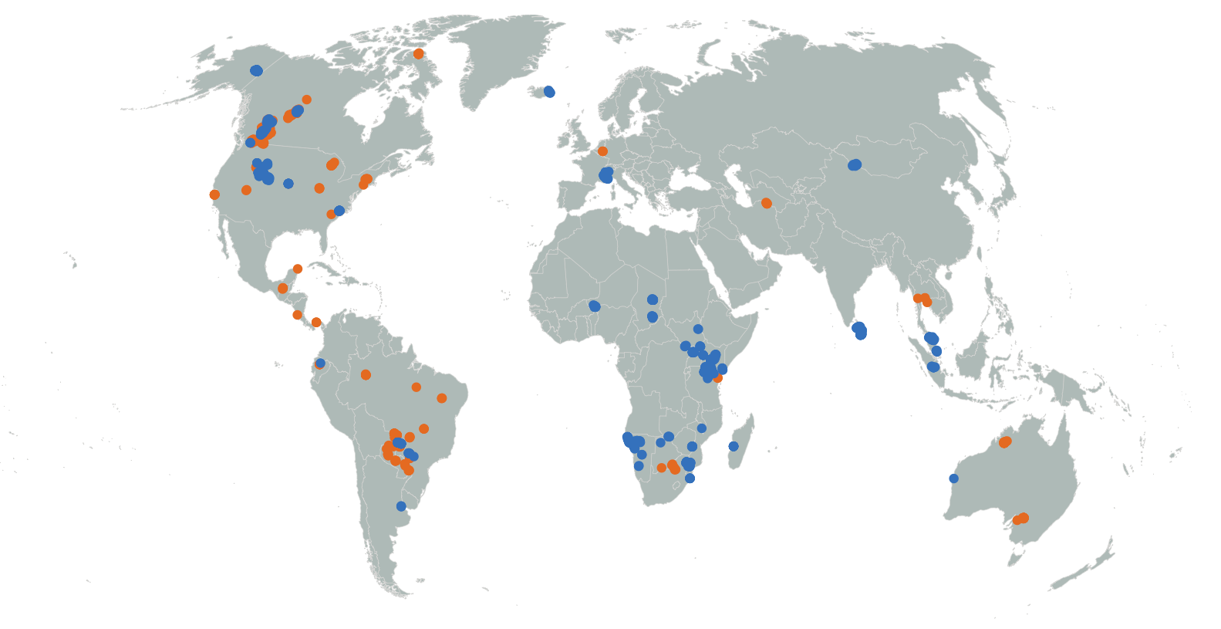
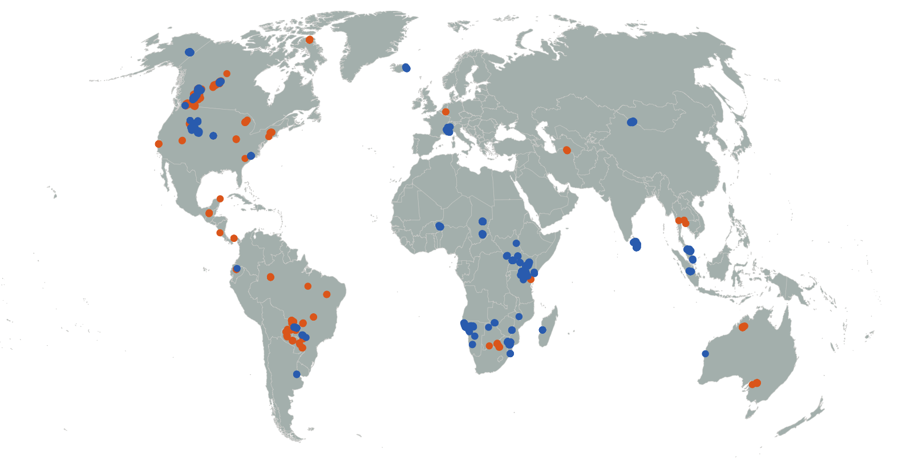
Chapter 3: Using a sample size greater than n = 1
Repeat HR analysis for:
3,000+ animals
85+ species
Estimate behaviors:
Between populations
Between species
Test for common behavior

Slide 20
Generalizing relationships (with energetics scaling with mass)

Slide 21
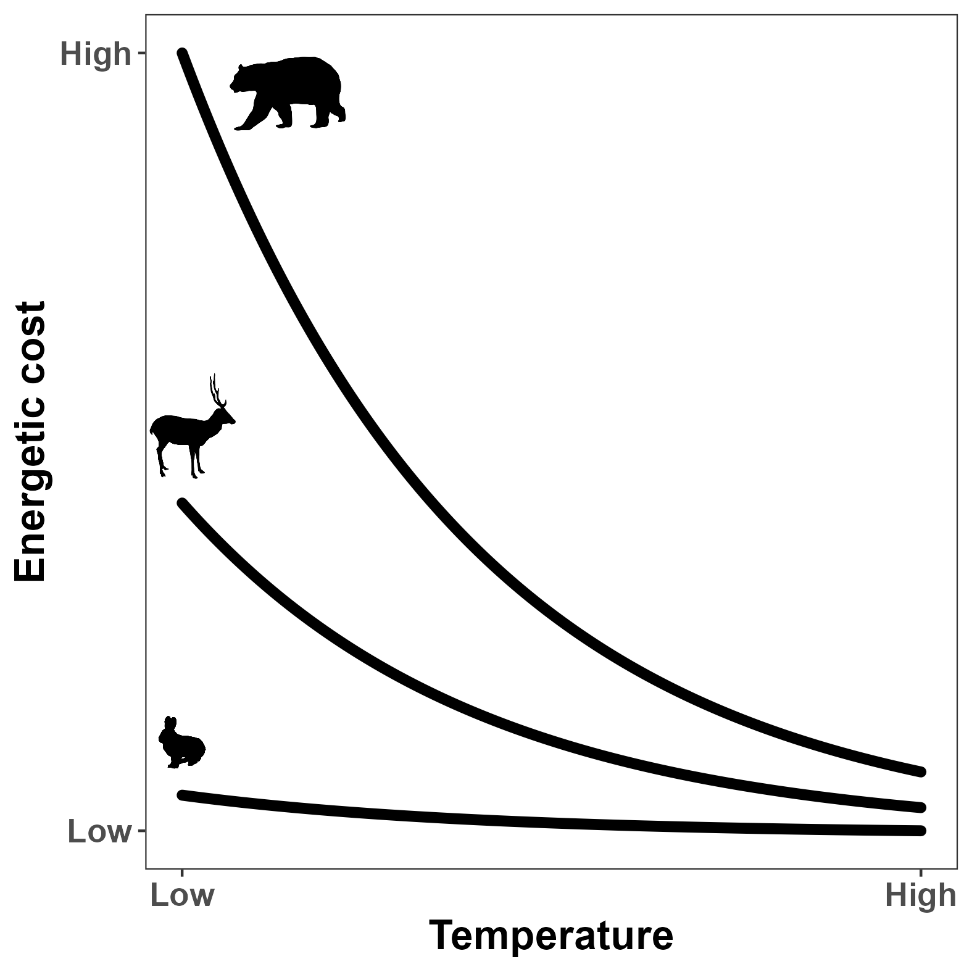
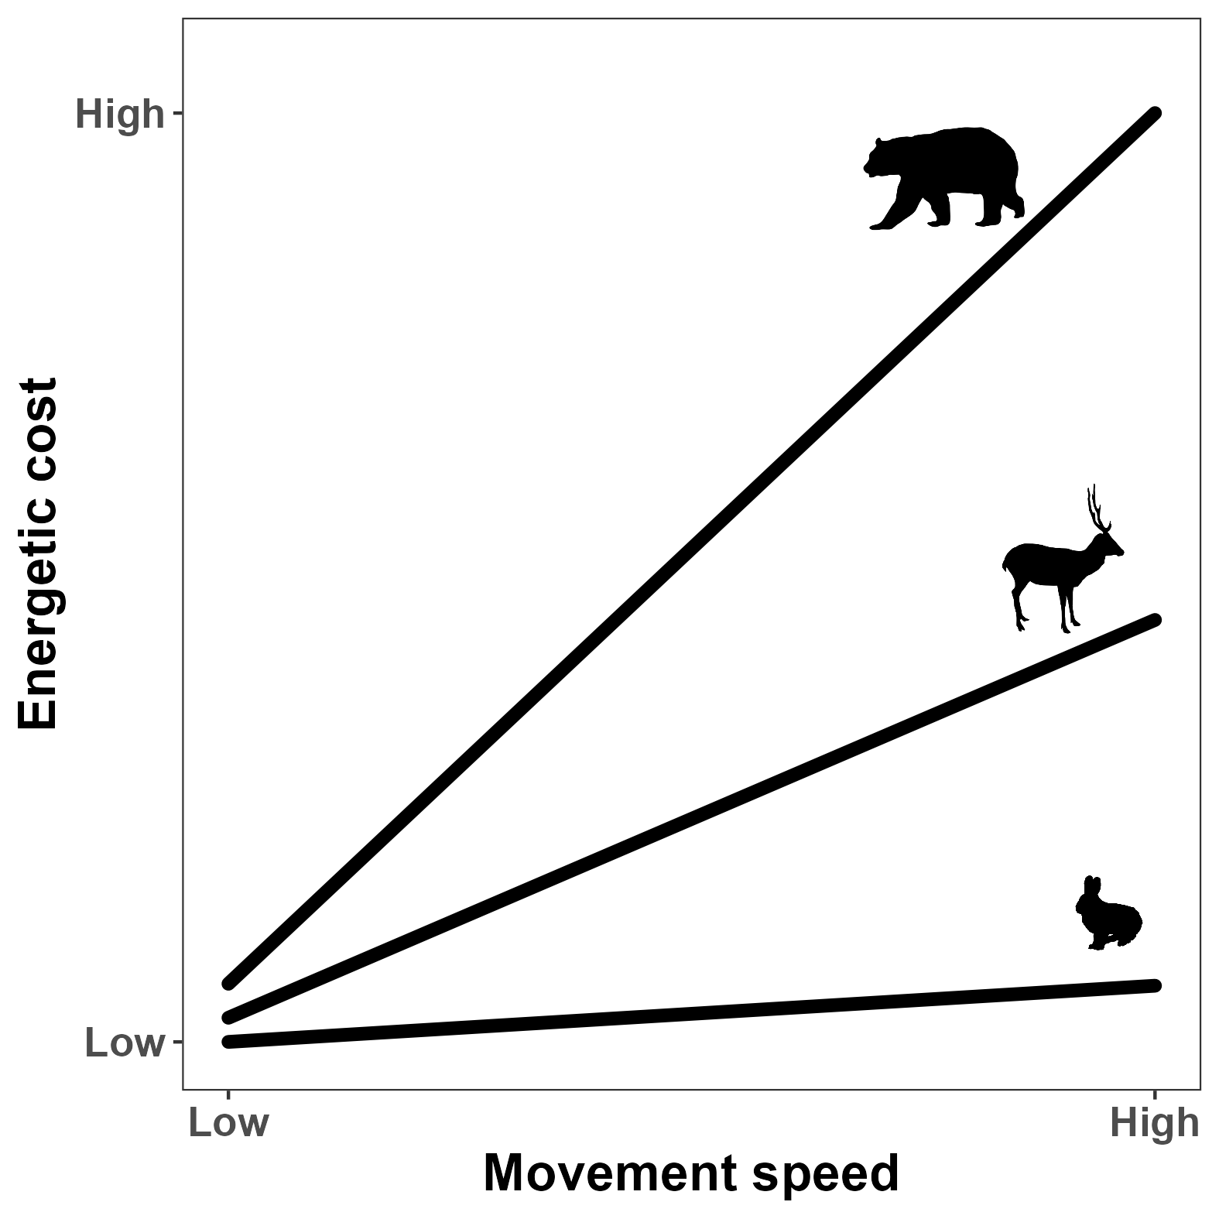

Energetic costs depends on temperature
$$I = I0 M^{3/4} e^{−cT}$$
$$E=10.7 M^{−0.684} v+6.03 M^{−0.697}$$
(Brown et al. 2004)
(Taylor et al. 1982)

Slide 22
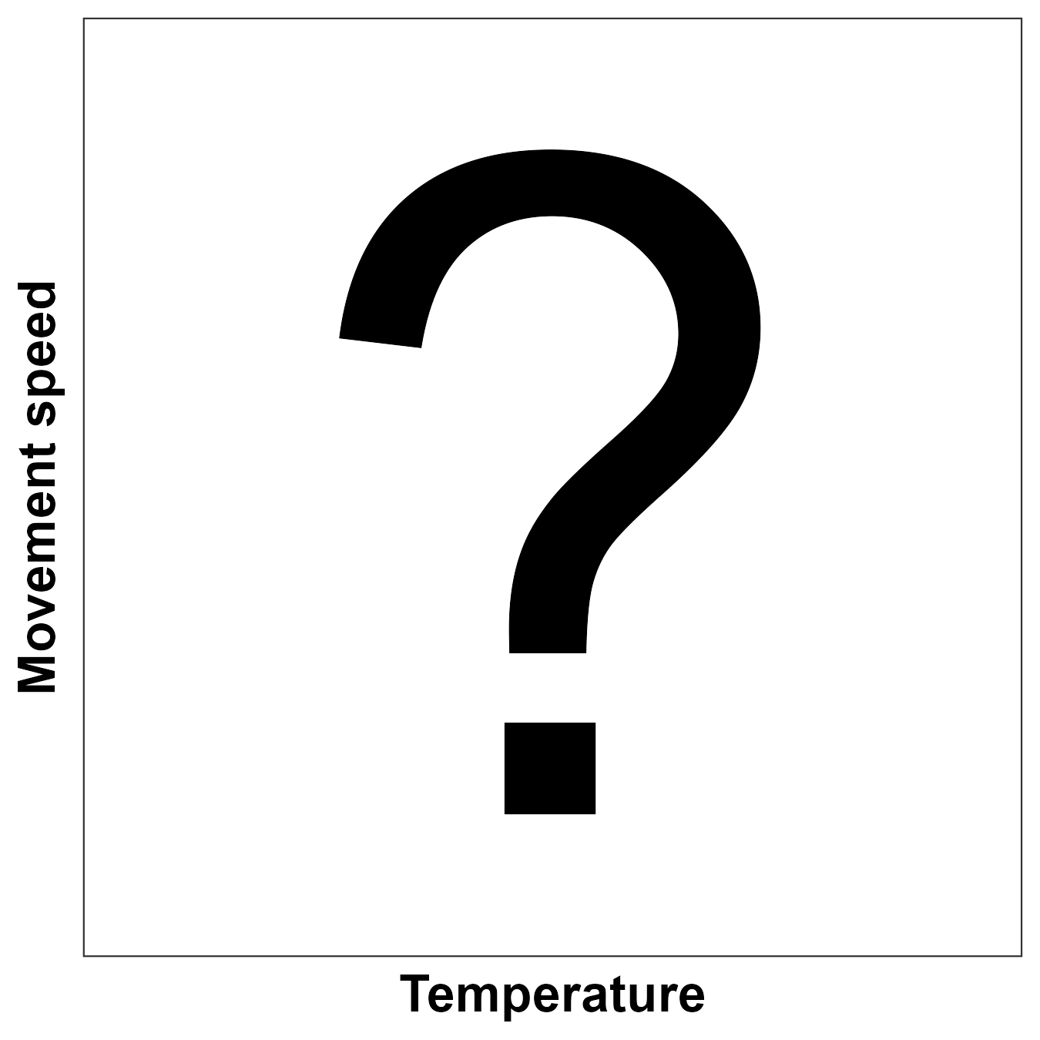
Chapter 4: Does movement depend on temperature?

Slide 23
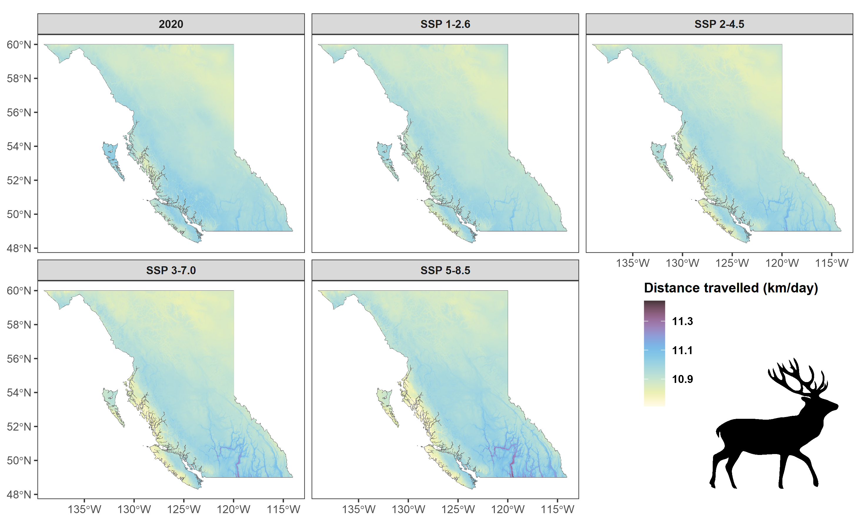
Predicting how elk will move in the future

Slide 24
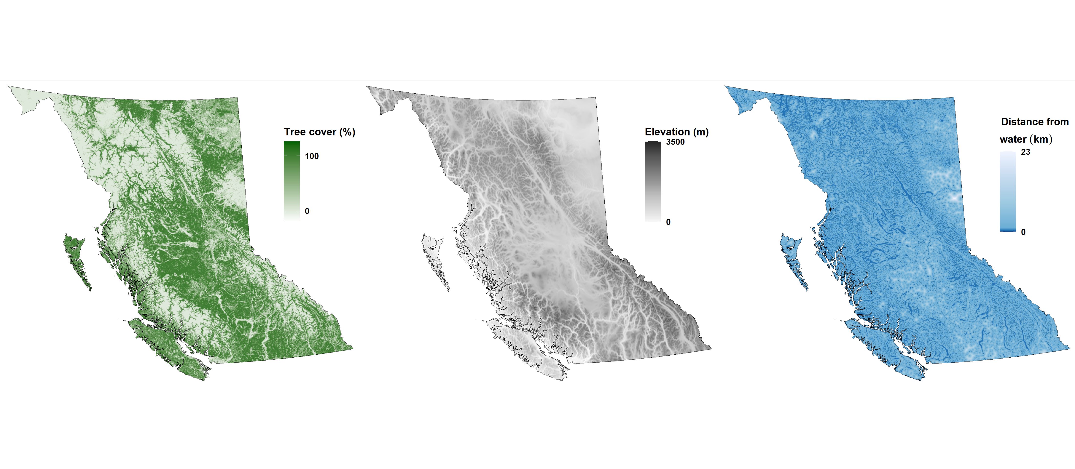
Assessing habitat selection

Slide 25
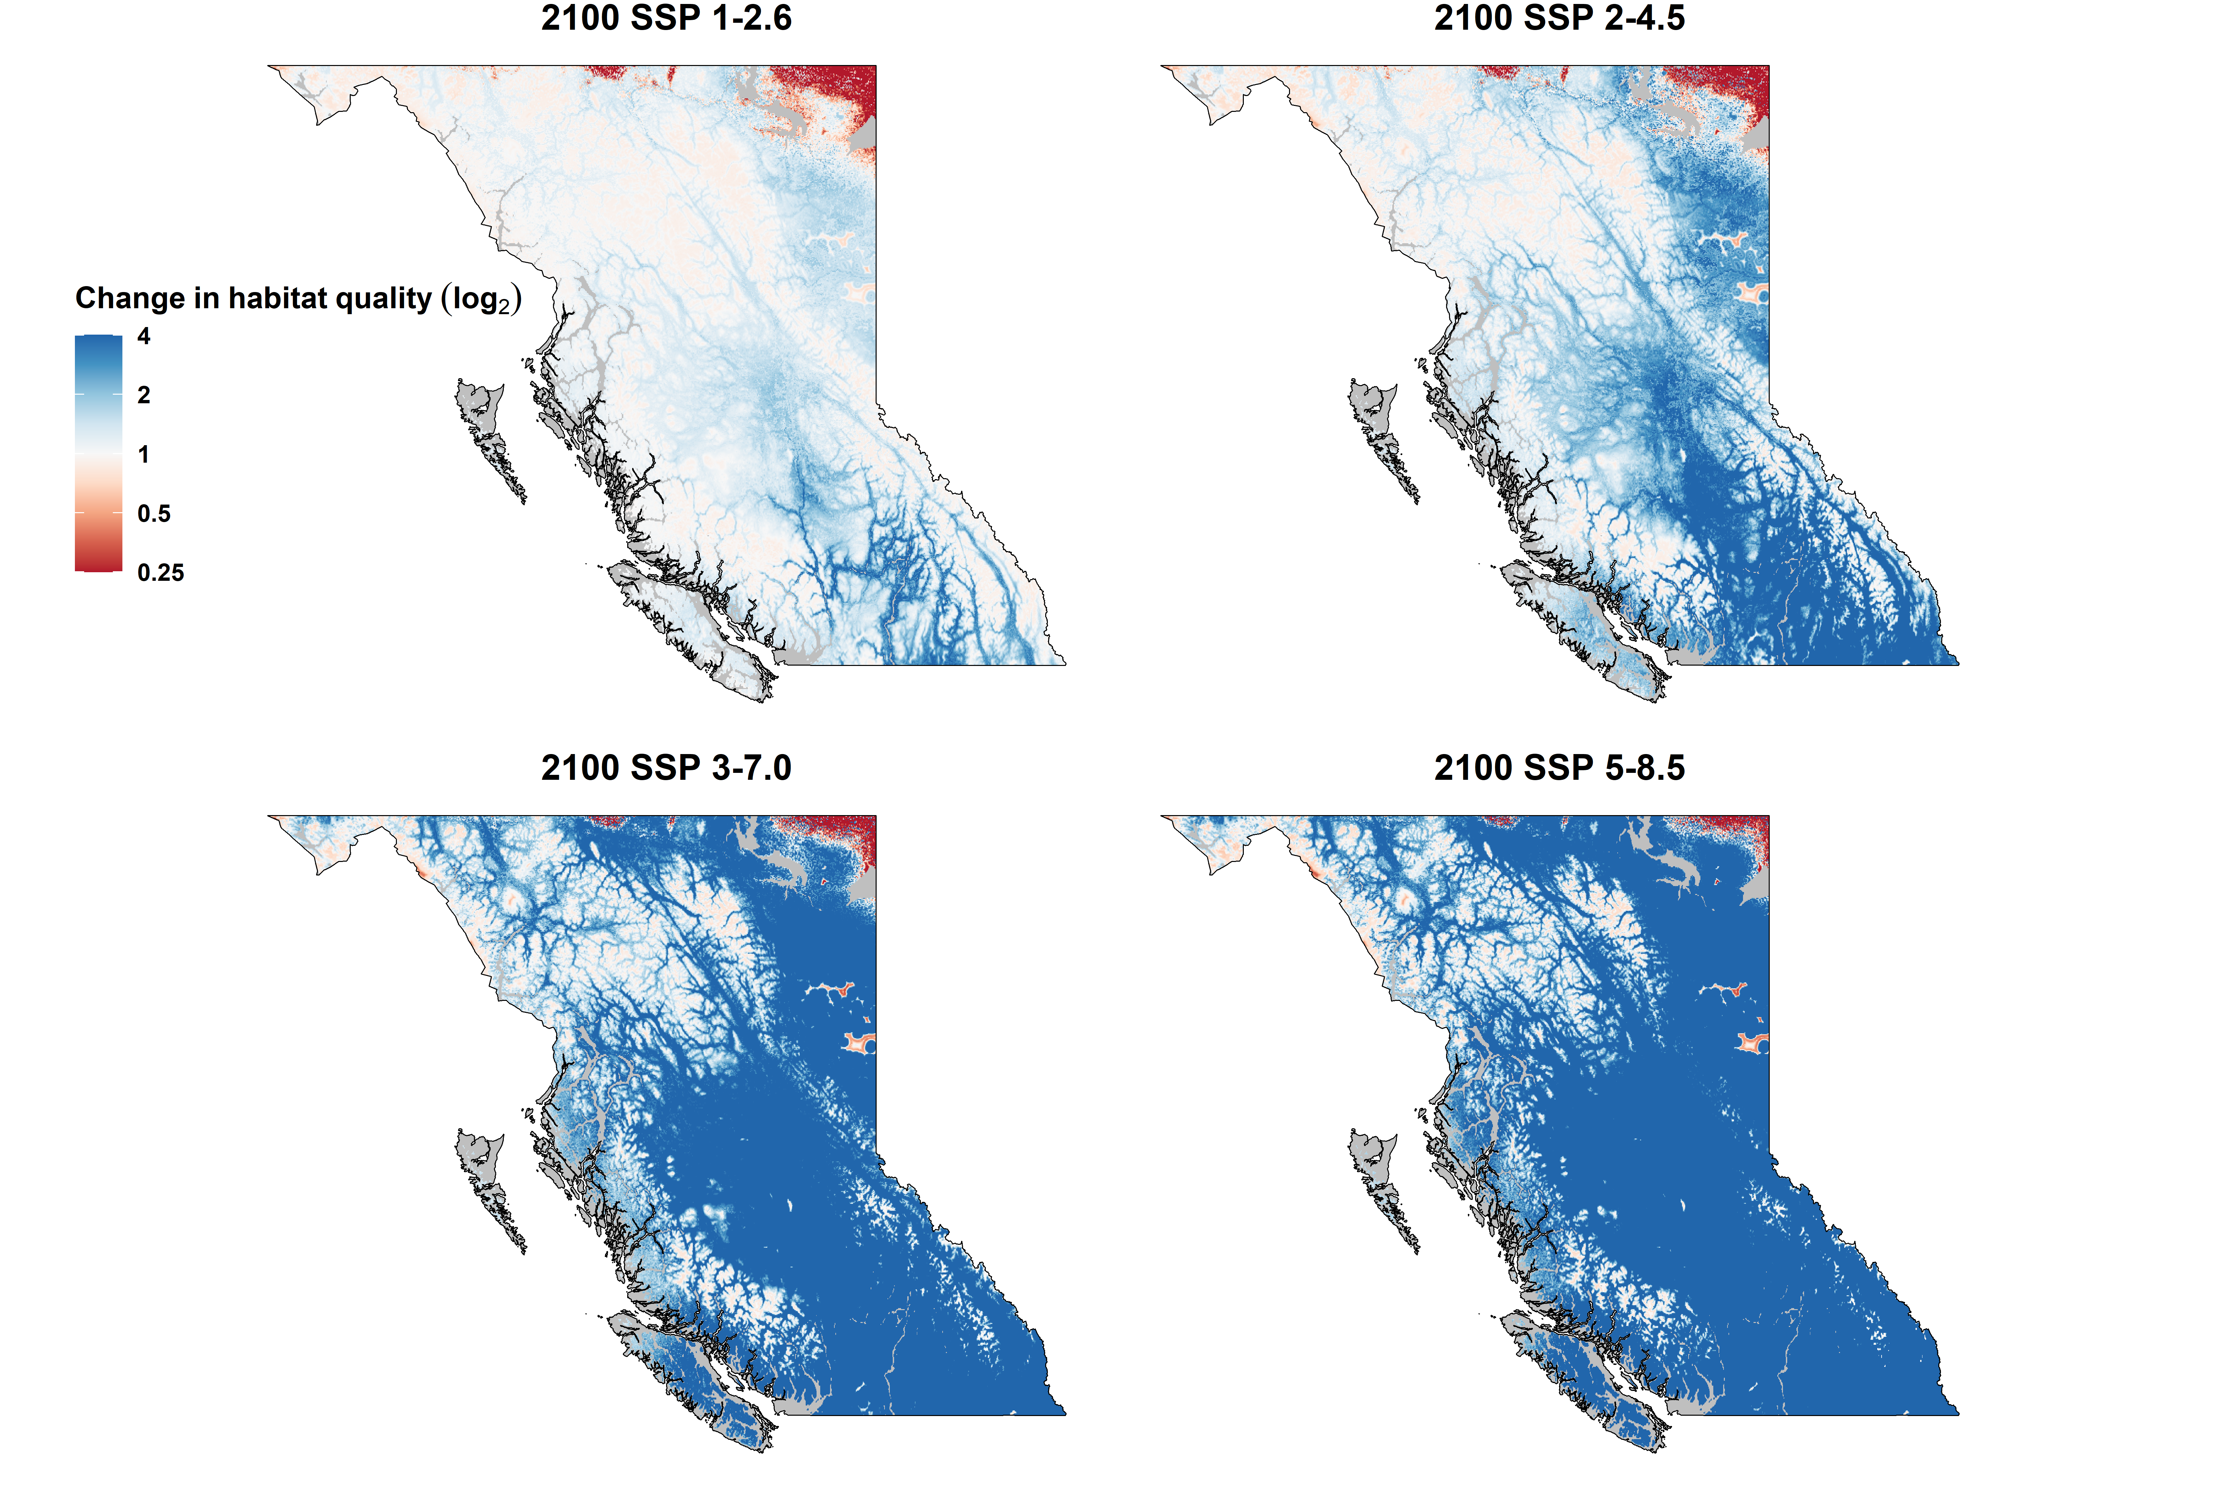

Elk habitat in 2100

Slide 26





Chapter 4: How will climate change affect mammal movement in BC?

Slide 27
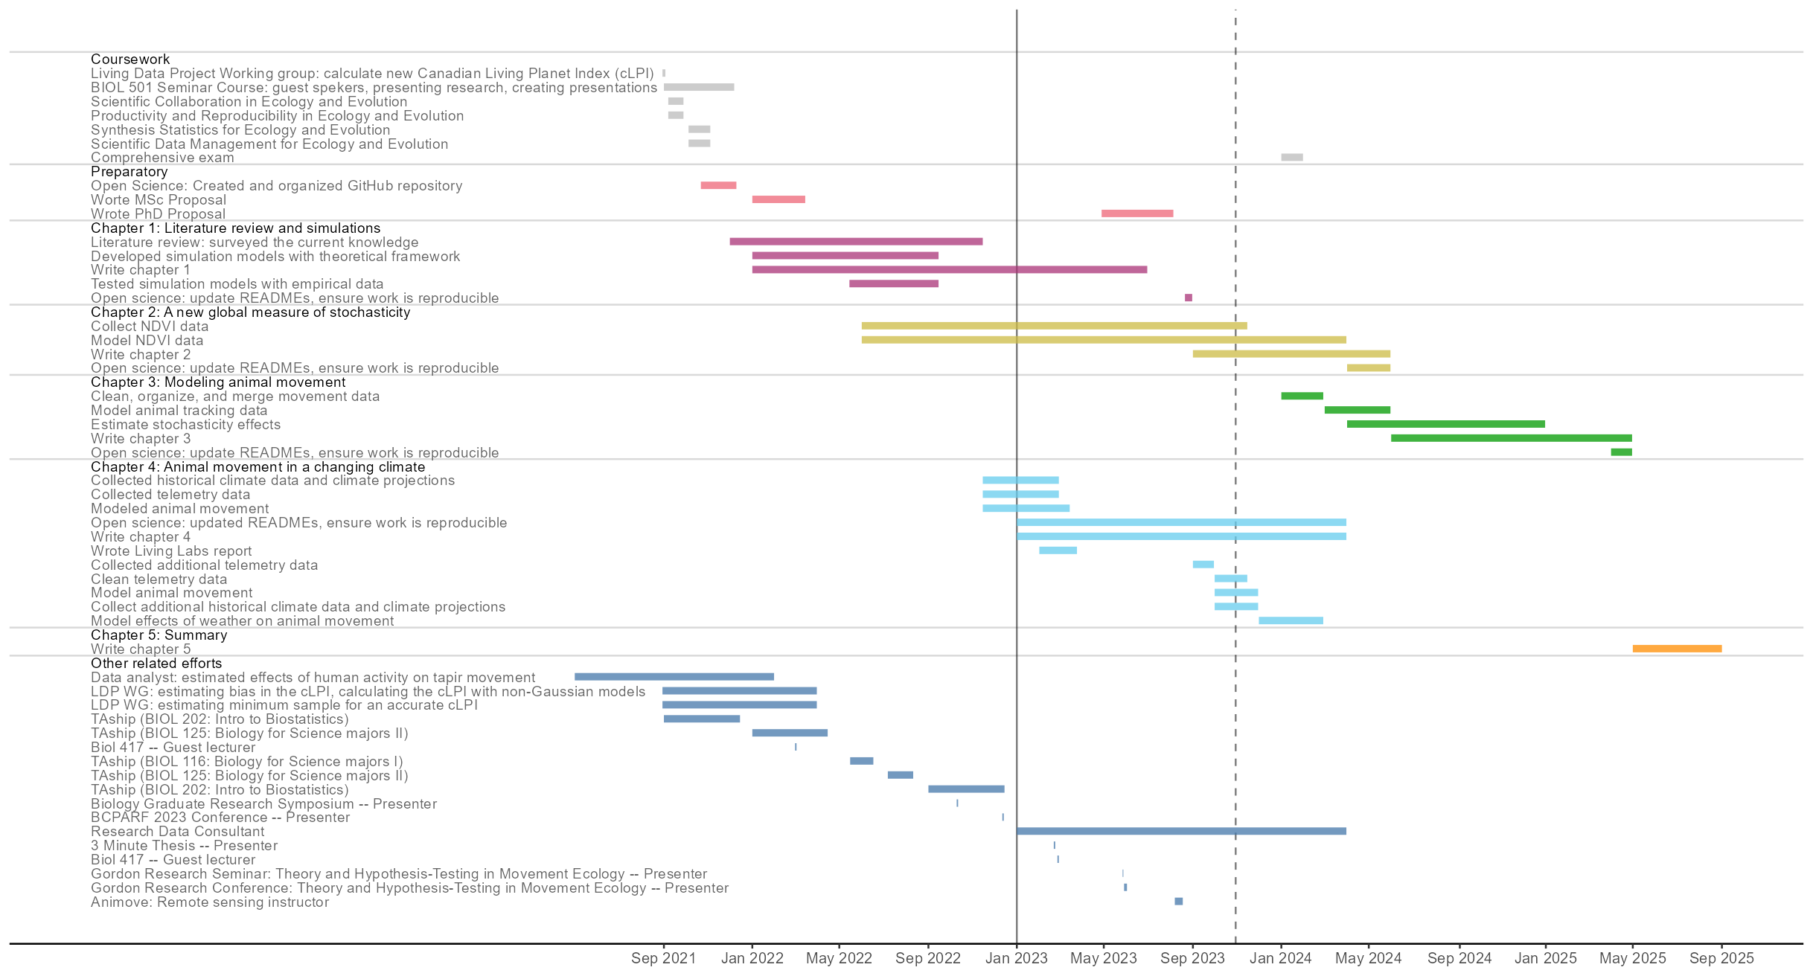

Slide 28







Slide 29
References
Bista, D., G. S. Baxter, N. J. Hudson, S. T. Lama, and P. J. Murray. 2022. Effect of disturbances and habitat fragmentation on an arboreal habitat specialist mammal using GPS telemetry: A case of the red panda. Landscape Ecology 37:795–809.
Geremia, C., J. A. Merkle, D. R. Eacker, R. L. Wallen, P. J. White, M. Hebblewhite, and M. J. Kauffman. 2019. Migrating bison engineer the green wave. Proceedings of the National Academy of Sciences 116:25707–25713.
Herfindal, I., J. D. C. Linnell, J. Odden, E. B. Nilsen, and R. Andersen. 2005. Prey density, environmental productivity and home-range size in the Eurasian lynx (Lynx lynx). Journal of Zoology 265:63–71.
Lucherini, M., and S. Lovari. 1996. Habitat richness affects home range size in the red fox Vulpes vulpes. Behavioural Processes 36:103–105.
Nilsen, E. B., I. Herfindal, and J. D. C. Linnell. 2005. Can intra-specific variation in carnivore home-range size be explained using remote-sensing estimates of environmental productivity? Écoscience 12:68–75.
Relyea, R. A., R. K. Lawrence, and S. Demarais. 2000. Home Range of Desert Mule Deer: Testing the Body-Size and Habitat-Productivity Hypotheses. The Journal of Wildlife Management 64:146.
Rickbeil, G. J. M., J. A. Merkle, G. Anderson, M. P. Atwood, J. P. Beckmann, E. K. Cole, A. B. Courtemanch, et al. 2019. Plasticity in elk migration timing is a response to changing environmental conditions. Global Change Biology 25:2368–2381.
Rizzuto M., Leroux S.J., Vander Wal E., Richmond I.C., Heckford T.R., Balluffi-Fry J., et al. (2021). Forage stoichiometry predicts the home range size of a small terrestrial herbivore. Oecologia 197, 327–338.
Williams-Guillen, K., C. McCann, J. C. Martinez Sanchez, and F. Koontz. 2006. Resource availability and habitat use by mantled howling monkeys in a Nicaraguan coffee plantation: Can agroforests serve as core habitat for a forest mammal? Animal Conservation 9:331–338.

